Slide 1
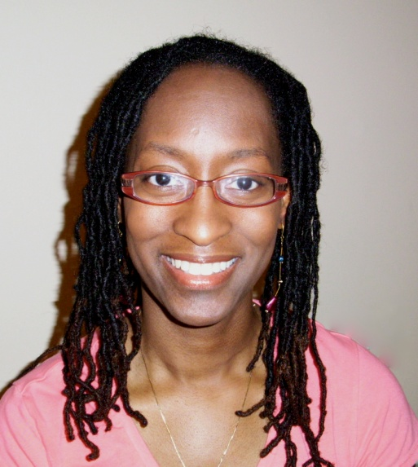
God Dwells Within You
By Anita G. Houser
Inspired by the teachings of
Gurumayi Chidvilasananda
© Anita G. Houser Published in 2007 by Heart Wind Music

Slide 2
[God dwells within you.
God dwells within me.
God is in ev'rything, ev'rything, Can you see?
Go into our hearts
and feel God there.
Then in the world
we'll see God ev'rywhere.] 2x

Slide 3
May we consciously be
that light we truly are, And shine that light
out into the world,
out into the world.

Slide 4
God dwells within you.
God dwells within me.
God is in ev'rything, ev'rything, Can you see?
Go into our hearts
and feel God there.
Then in the world
we'll see God ev'rywhere.

Slide 5
May we consciously be
that light we truly are, And shine that light
out into the world,
out into the world.

Slide 6
God dwells within you.
God dwells within me.
God is in ev'rything, ev'rything, Can you see?
Go into our hearts
and feel God there.
Then in the world
we'll see God ev'rywhere.

